Slide 1
Key Principles of Software Architecture
Mahesh Shirole
Microsoft Application Architecture Guide

Slide 2
Agenda
Common Application Architecture
Key Design Principles
Key Design Considerations

Slide 3
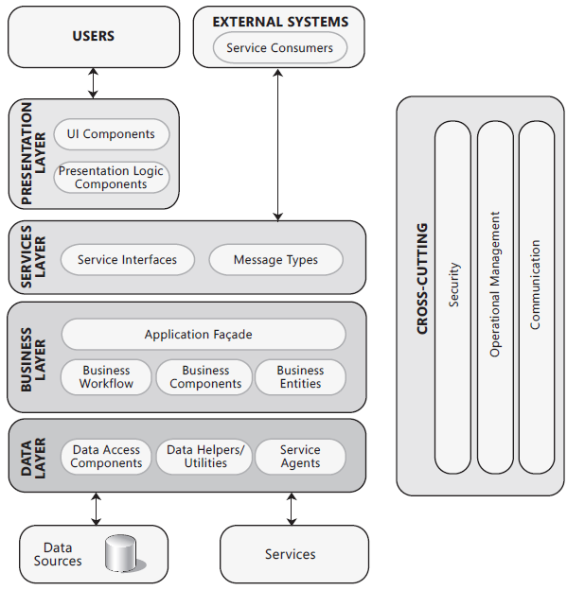
Common Application Architecture

Slide 4
Key Design Principles
The key principles that will help you to create an architecture that
adheres to proven principles
minimizes costs and maintenance requirements
promotes usability and extendibility
The Key Design principles are:
Separation of concerns
Singe responsibility principle
Principle of least knowledge
Do not repeat yourself
Minimize upfront design

Slide 5
Key Design Principles
Separation of concerns
Divide your application into distinct features with as little overlap in functionality as possible
The important factor is minimization of interaction points to achieve high cohesion and low coupling
Single Responsibility principle
Each component or module should be responsible for only a specific feature or functionality, or aggregation of cohesive functionality
Principle of Least Knowledge
A component or object should not know about internal details of other components or objects
Don’t repeat yourself (DRY)
Functionality should be implemented in only one component
Minimize upfront design
Only design what is necessary

Slide 6
Design Practices
Keep design patterns consistent within each layer
Do not duplicate functionality within an application
Prefer composition to inheritance
Establish a coding style and naming convention for development
Maintain system quality using automated QA techniques during development
Consider the operation of your application

Slide 7
Application Layer Practices
Separate the areas of concern
Be explicit about how layers communicate with each other
Use abstraction to implement loose coupling between layers
Do not mix different types of components in the same logical layer
Keep the data format consistent within a layer or component

Slide 8
Component Modules and Functions - Practices
A component or an object should not rely on internal details of other components or objects
Do not overload the functionality of a component
Understand how components will communicate with each other
Keep crosscutting code abstracted from the application business logic as far as possible
Define a clear contract for components

Slide 9
Key Design Considerations
These are major decisions to develop architecture
Determine the Application Type
Determine the Deployment Strategy
Determine the Appropriate Technologies
Determine the Quality Attributes
Determine the Crosscutting Concerns

Slide 10
Determine the Application Type
Choosing the appropriate application type is the key part of the process of designing an application
Choice is governed by your specific requirements and infrastructure limitations
Mobile applications designed for mobile devices
Rich client applications designed to run primarily on a client PC
Rich Internet applications designed to be deployed from the Internet, which support rich UI and media scenarios
Service applications designed to support communication between loosely coupled components
Web applications designed to run primarily on the server in fully connected scenarios
Cloud-based applications designed to host on cloud and provide services

Slide 11
Determine the Deployment Strategy
Your application may be deployed in a variety of environments, each with its own specific set of constraints such as
physical separation of components across different servers
limitation on networking protocols
firewall and router configurations
Common deployment patterns are distributed and non-distributed scenarios
These factors will influence your architecture design

Slide 12
Determine the Appropriate Technologies
The key factors to consider are the type of application you are developing and your preferred options for application deployment topology and architectural styles
Your choice of technologies will also be governed by organization policies, infrastructure limitations, resource skills, and so on

Slide 13
Determine the Quality Attributes
Quality attributes—such as security, performance, and usability—can be used to focus your thinking on the critical problems that your design should solve
Quality attributes are system properties that are separate from the functionality of the system
From a technical perspective, implementing quality attributes can differentiate a good system from a bad one
There are two types of quality attributes:
measured at run time (speed, response time)
estimated through inspection (usability, security)
Analyze the tradeoffs between quality attributes

Slide 14
Determine the Crosscutting Concerns
Crosscutting concerns represent key areas of your design that are not related to a specific layer in your application
A logging mechanism that allows each layer to log to a common store, or log to separate stores
A mechanism for authentication and authorization that passes identities across multiple layers
An exception management framework that will work within each layer
A communication approach that you can use to communicate between the layers
A common caching infrastructure that allows you to cache data in the presentation layer, the business layer, and the data access layer

